Slide 1
Spatial Database Project CS-621
Analysis on the crimes against children in Chicago.
By : Atikant Negi (19253717)

Slide 2
Motivation
The purpose of the topic is to draw the attention of the viewers to the increasing number of crimes against children all over the world . Just in a year from 2018-2019 there was a significant increase of 4.5%.
Reference : http://www.unh.edu/ccrc/factsheet.html
As the data is large, I will delve into a small area to analyze the data . Here I have picked up Chicago , Illinois ,United States of America for the same.

Slide 3
Project Layout
Data extraction & Data Manupulation
Analysis:
1. Analysis done of the crimes near schools
2. Analysis done of the crimes near park.
3. Analysis done of the crimes near police stations
4. General analysis
Conclusion

Slide 4
Data extraction
The data was taken from sources mentioned below:
https://data.cityofchicago.org
https://www.chicago.gov/
https://download.geofabrik.de/north-america/us/illinois.html
Data Manupulation
Data set was collected in form of shape files and csv.
The csv’s were added to Qgis as delimited text layers and then exported as sql files for further data set refinement and creating views for analysis.

Slide 5
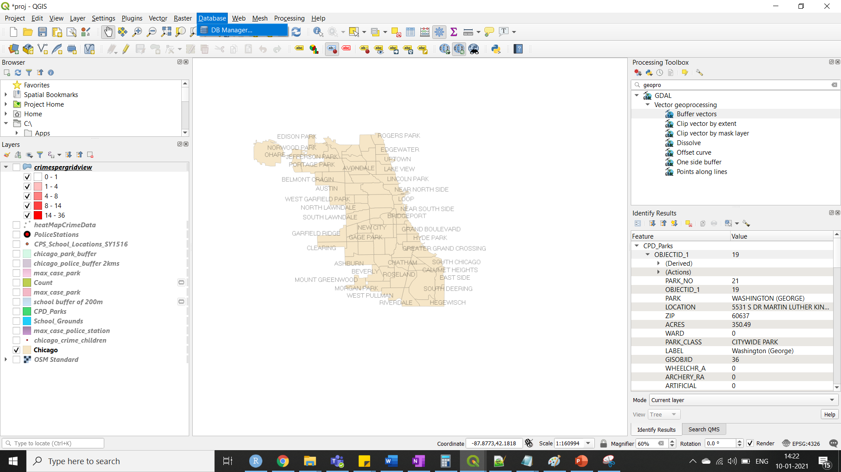
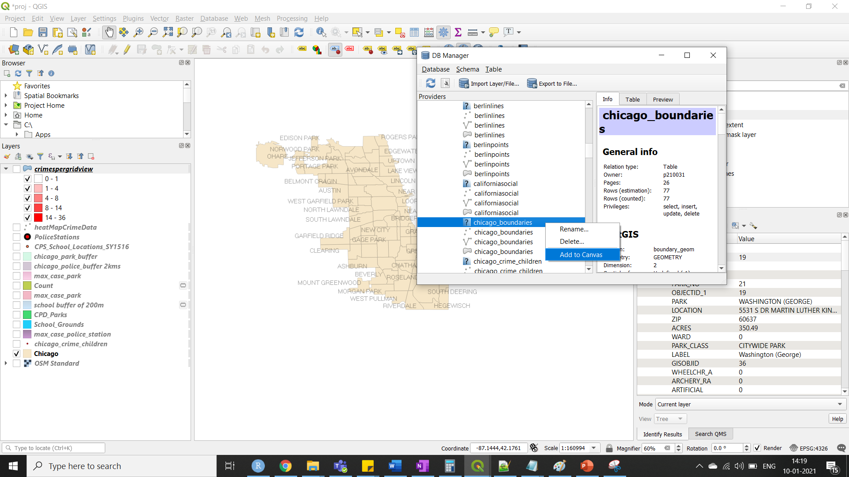
Setting the Base layer
The table data for the layers are also attached with the zip of the project folder for reference https://github.com/Atikant/ChicagoCrimeQgis

Slide 6
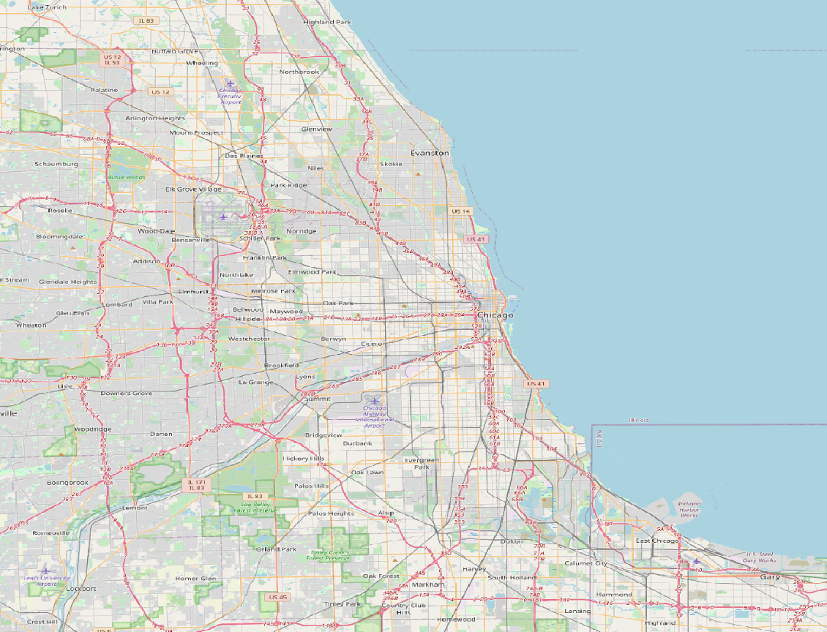
Open street view of Chicago

Slide 7
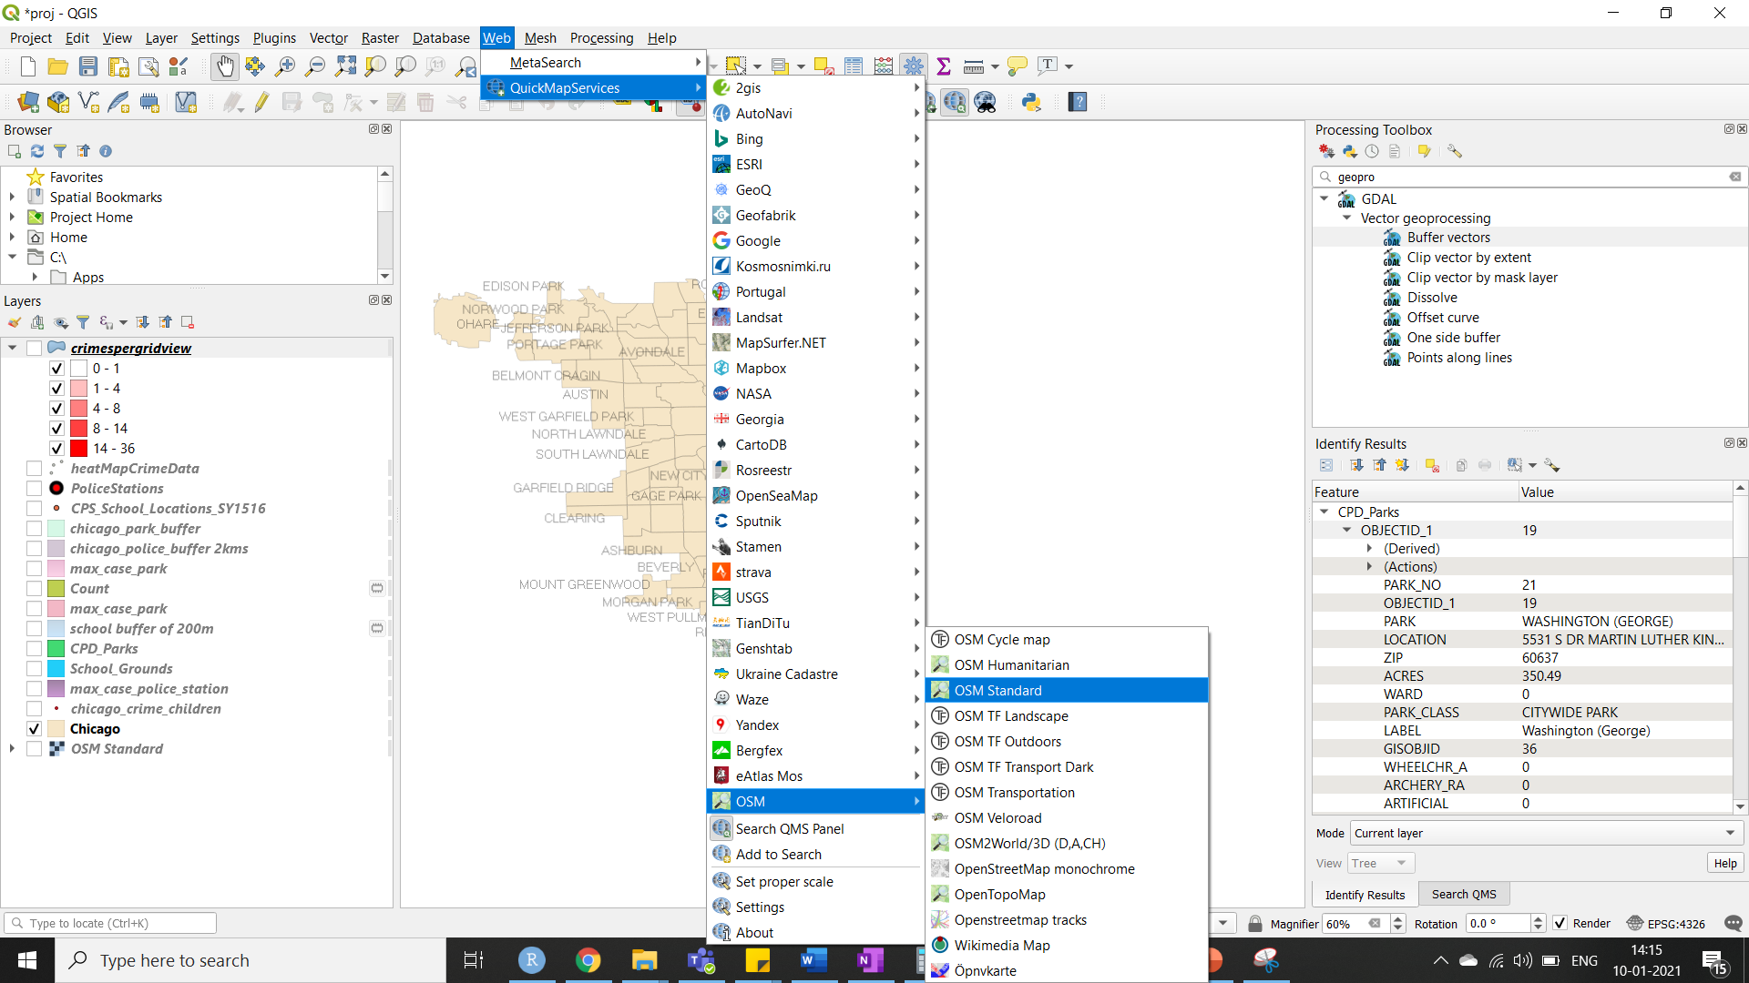
Adding OSM

Slide 8
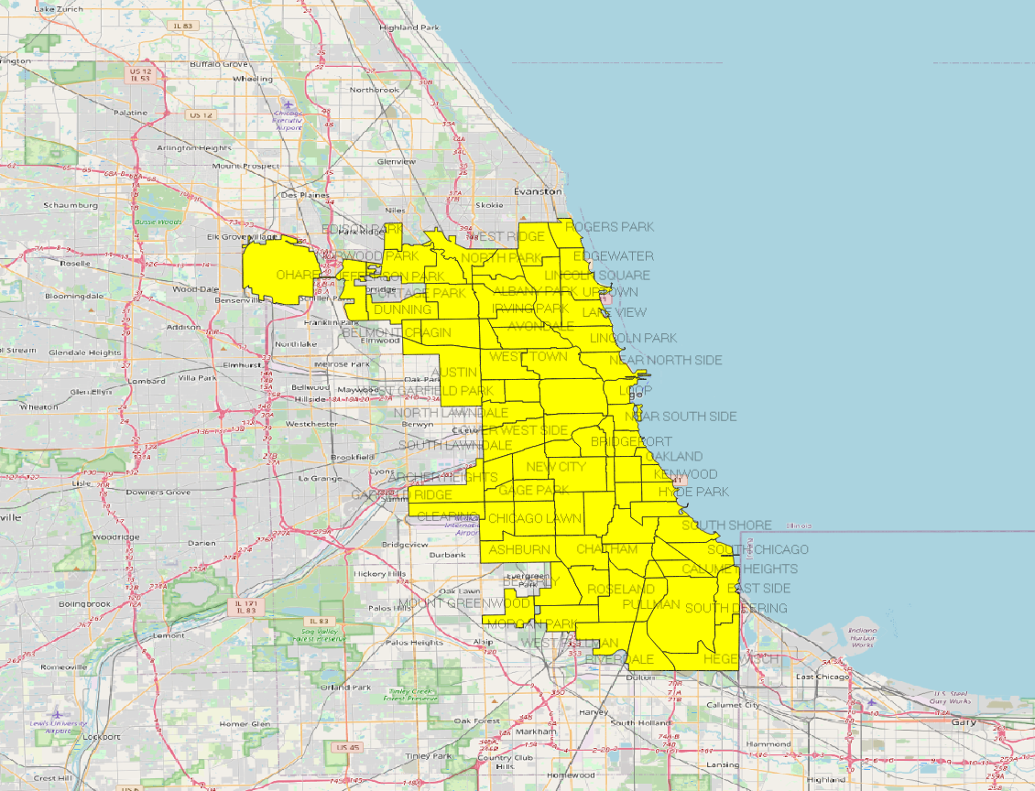
Areas in chicago

Slide 9
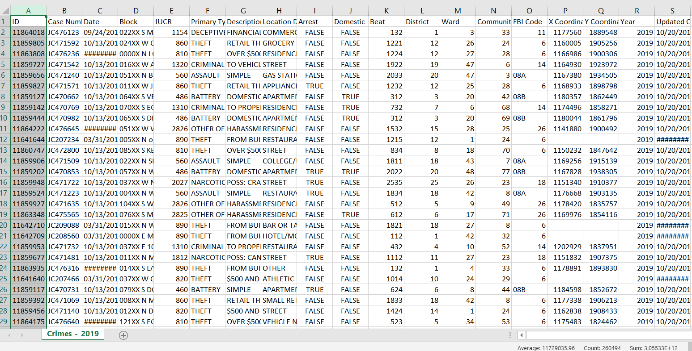
Large data manupulation
The CSV file for the crimes in the year 2019 had 260494. But this project deals mainly on primary type as kidnapping and offense against children that amounts to 2498 records.

Slide 10
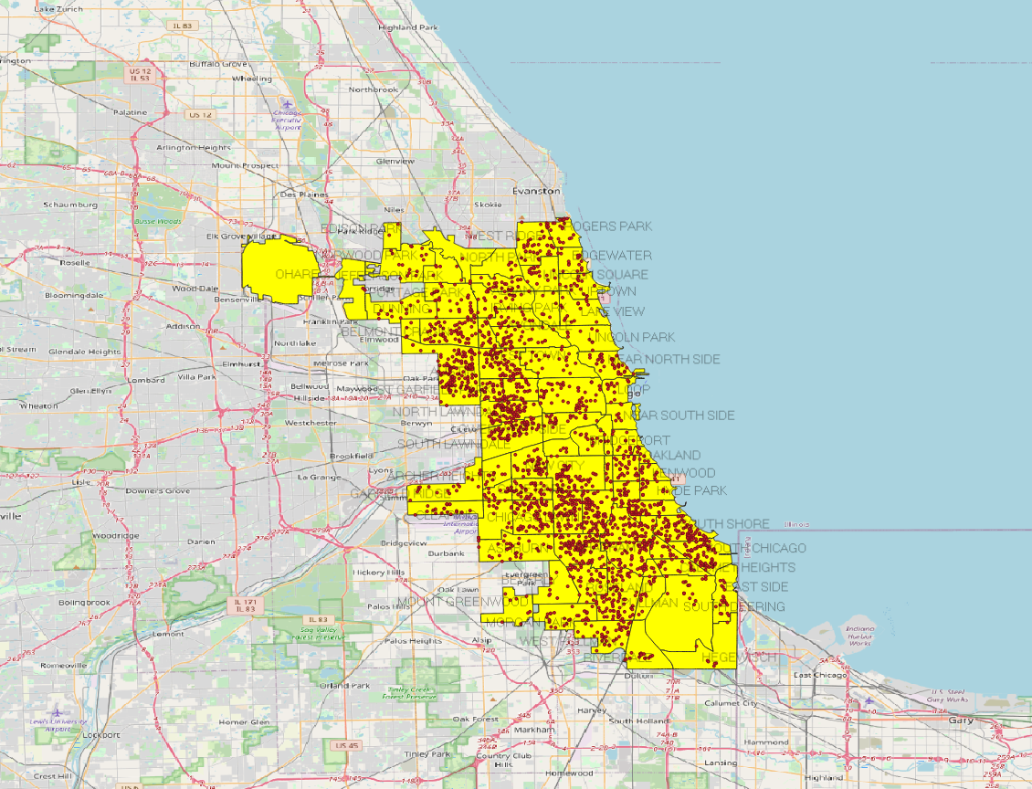
Crimes reported administrative boundaries

Slide 11
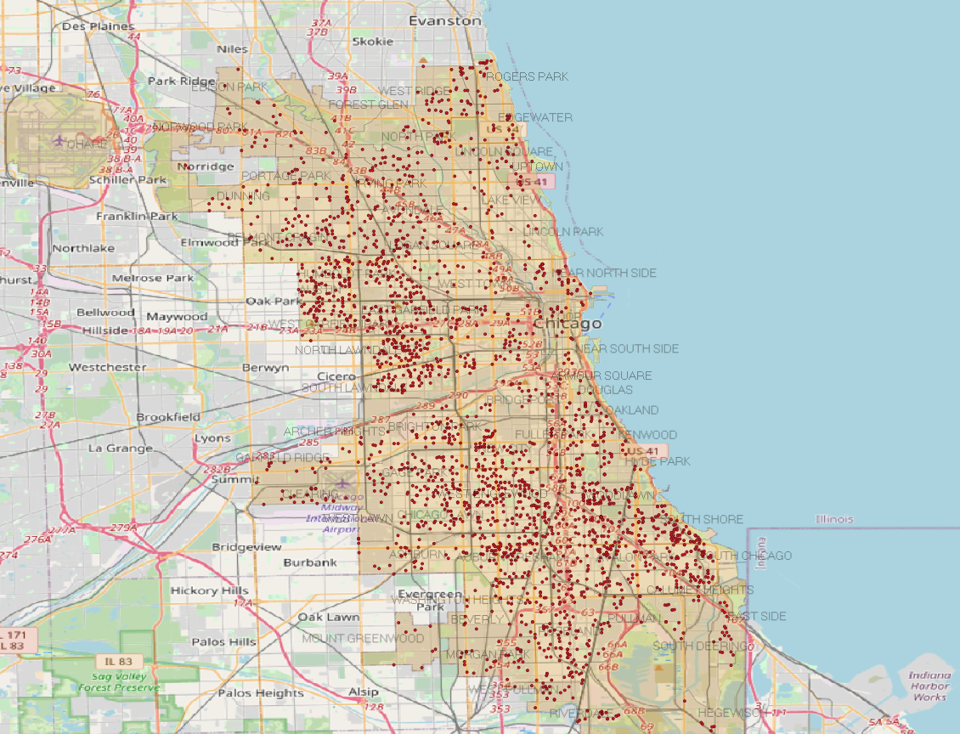
Crimes plotted through out chicago

Slide 12
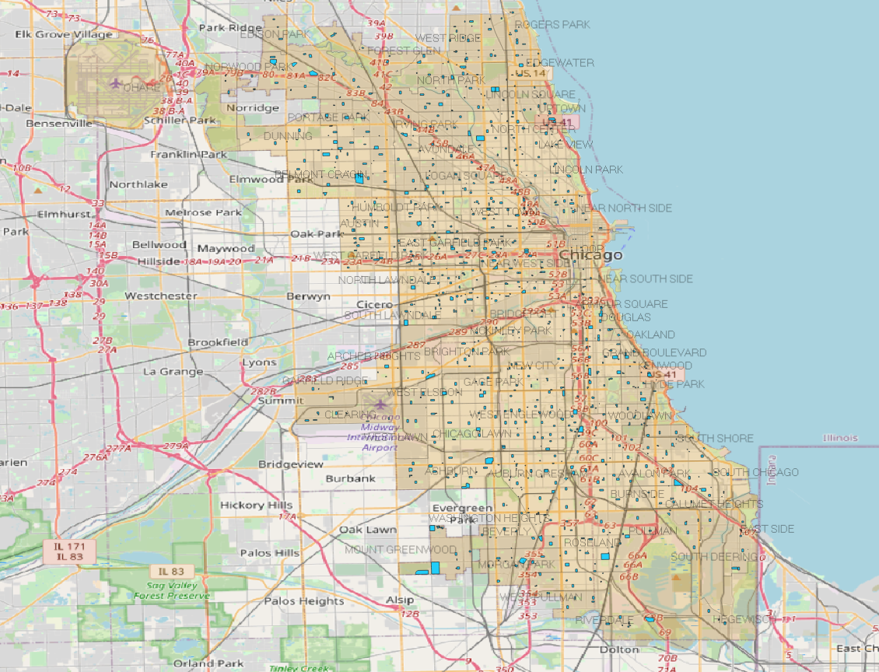
Schools

Slide 13
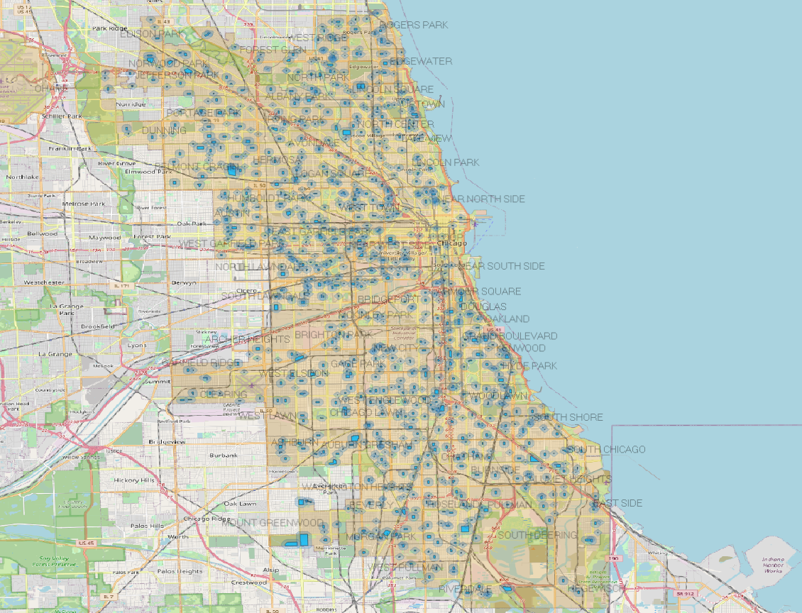
School Buffer 200m

Slide 14
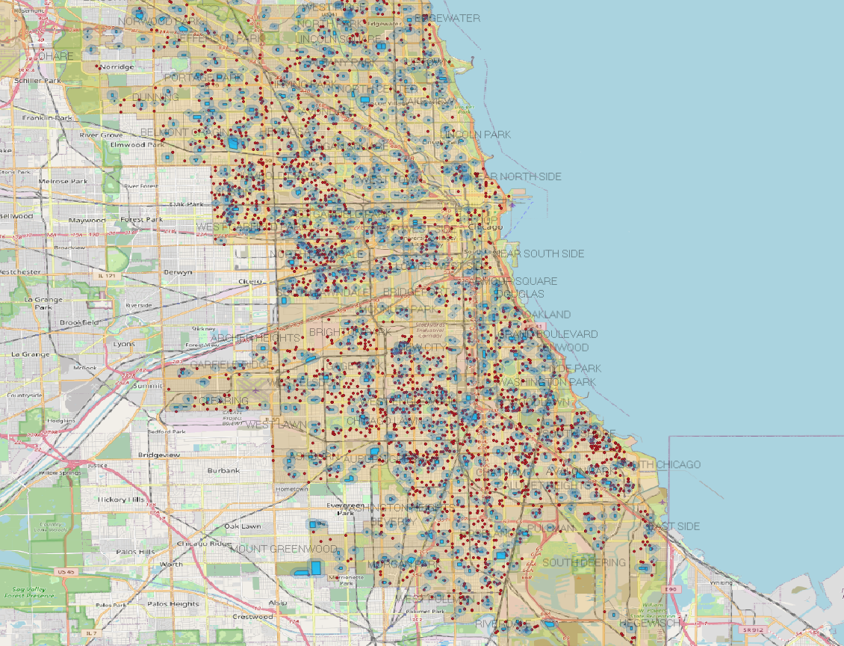
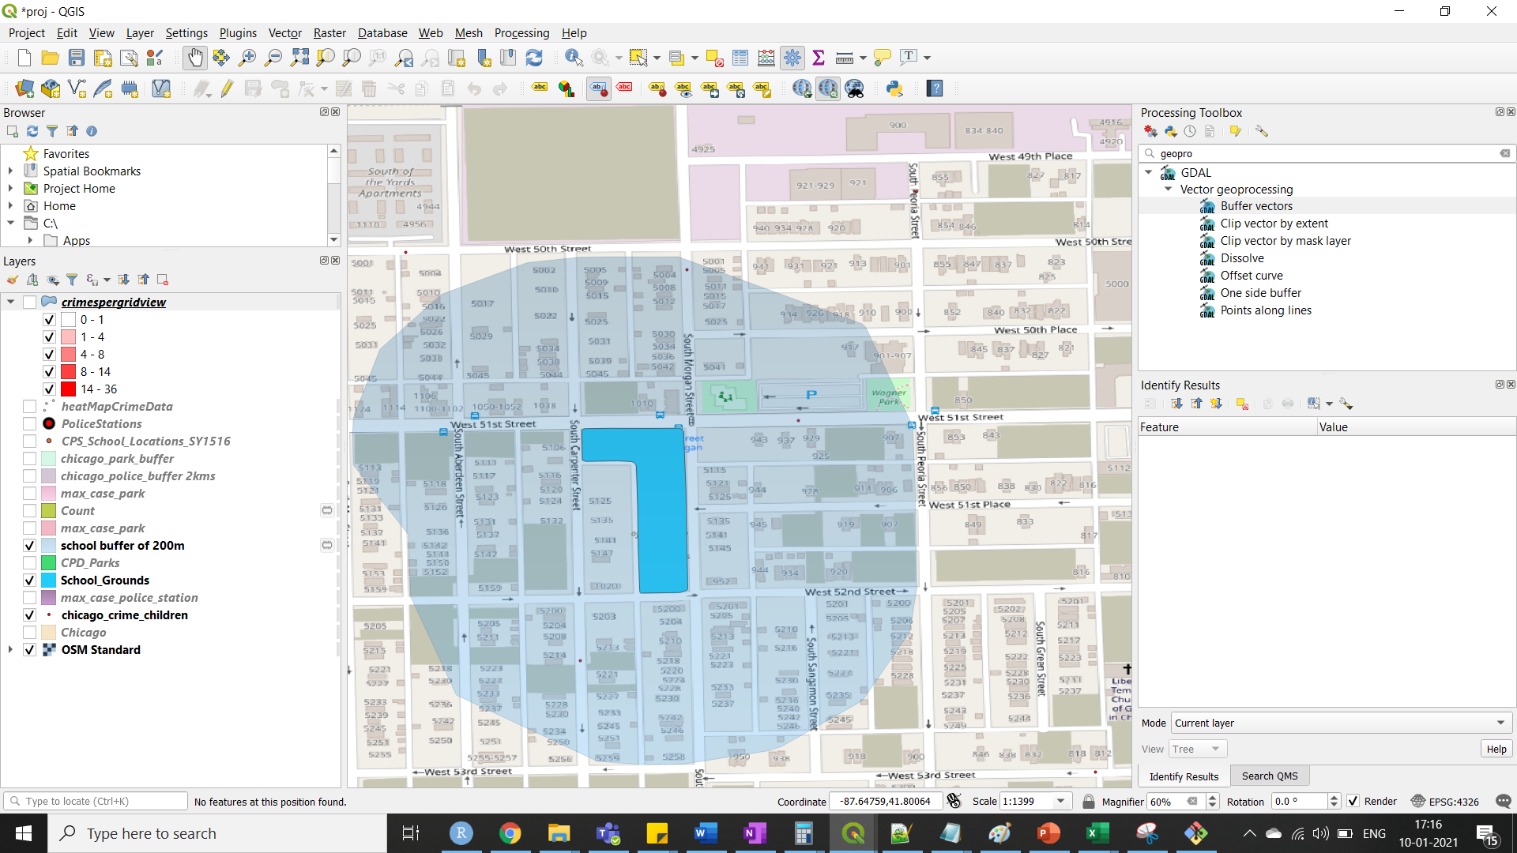
Schools along with crimes

Slide 15
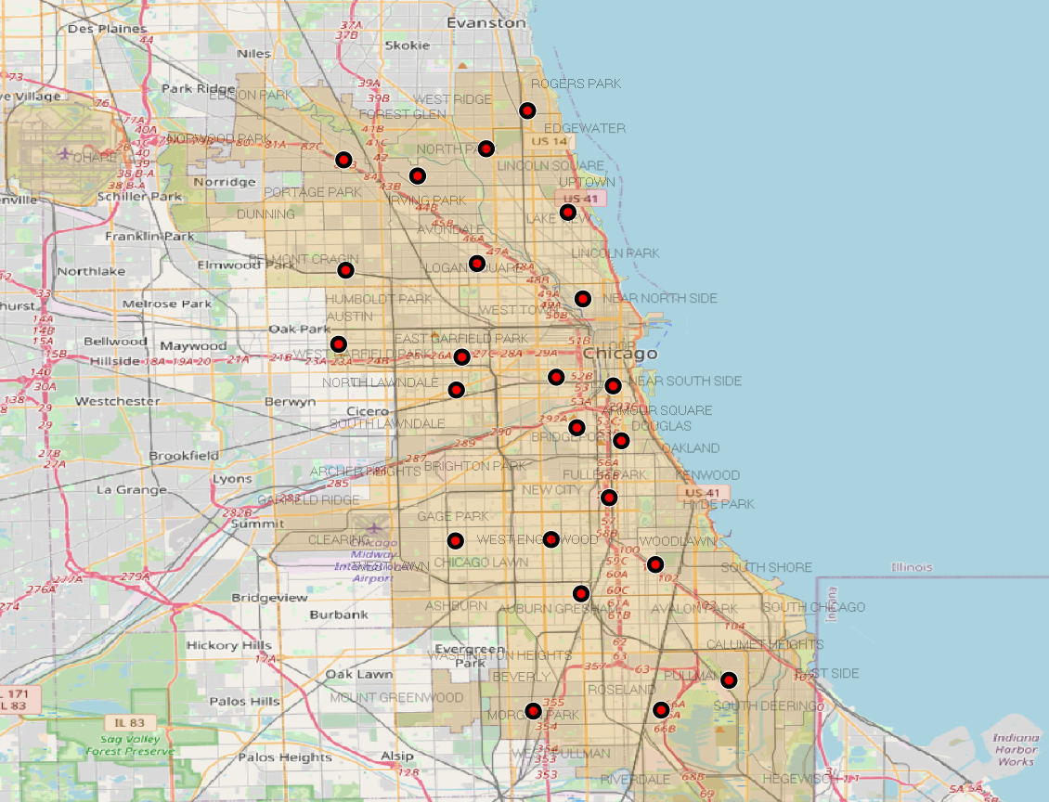
Police station

Slide 16
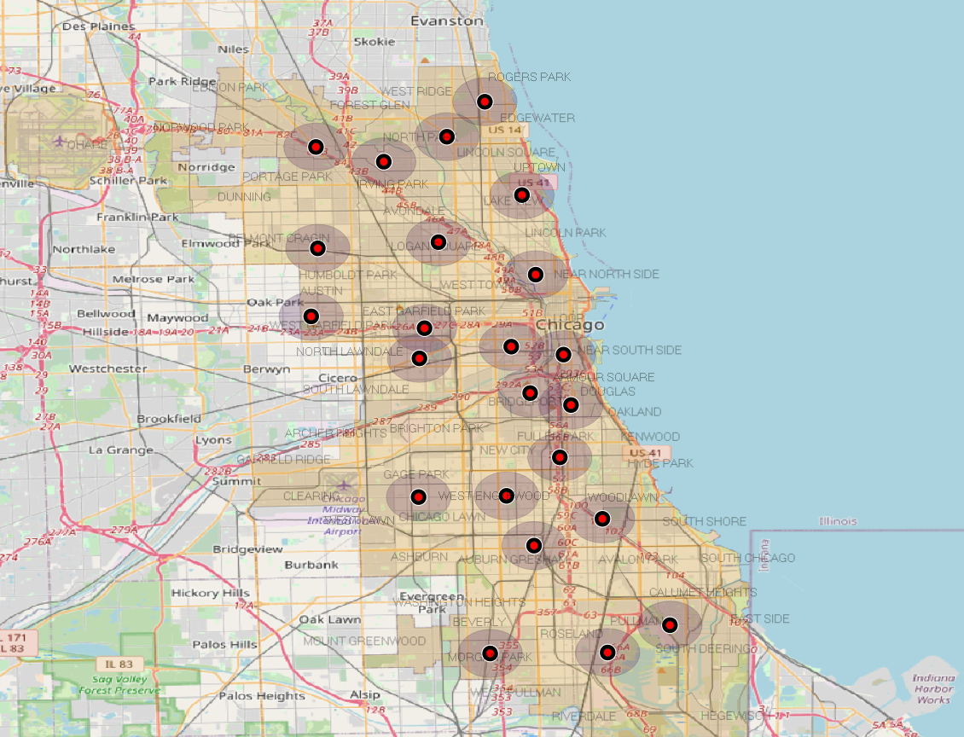
Police stations with 2km buffer

Slide 17
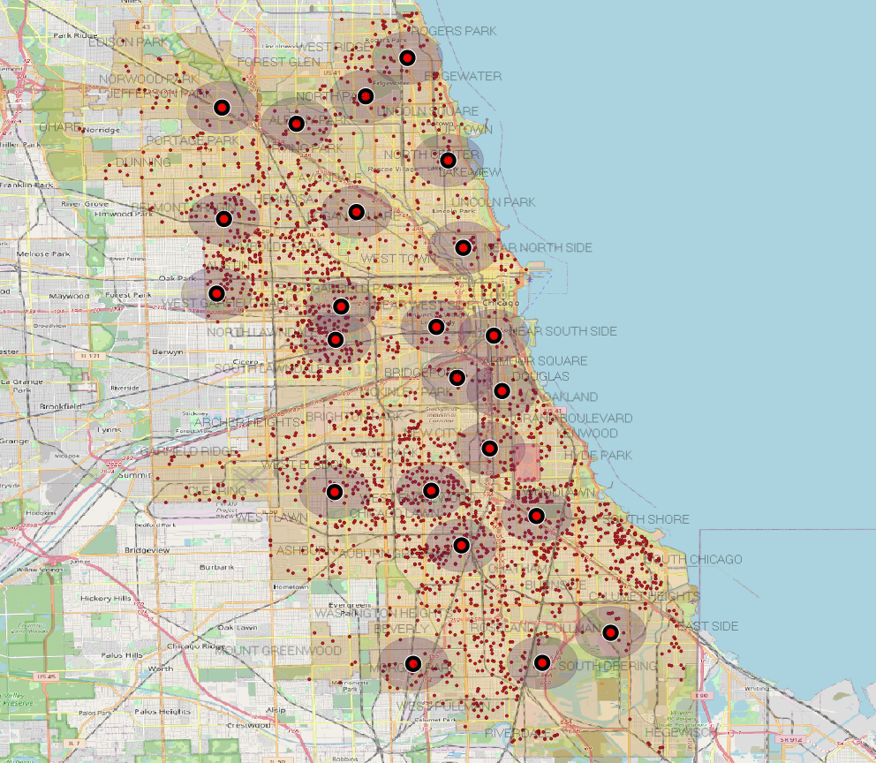
Police stations and crimes.

Slide 18
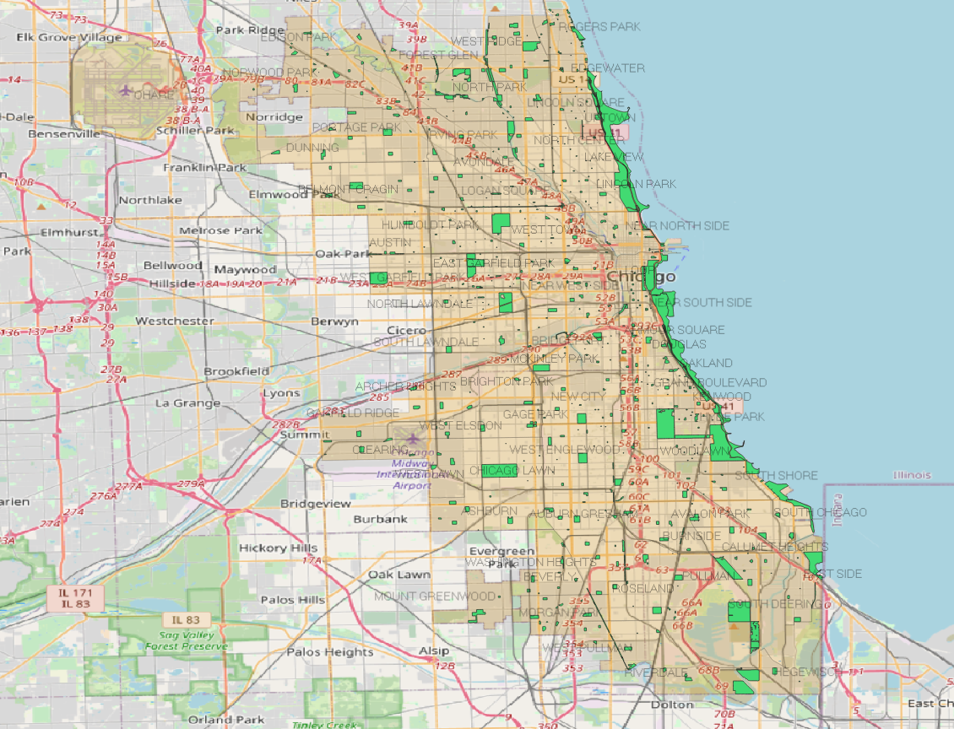
Parks in Chicago

Slide 19
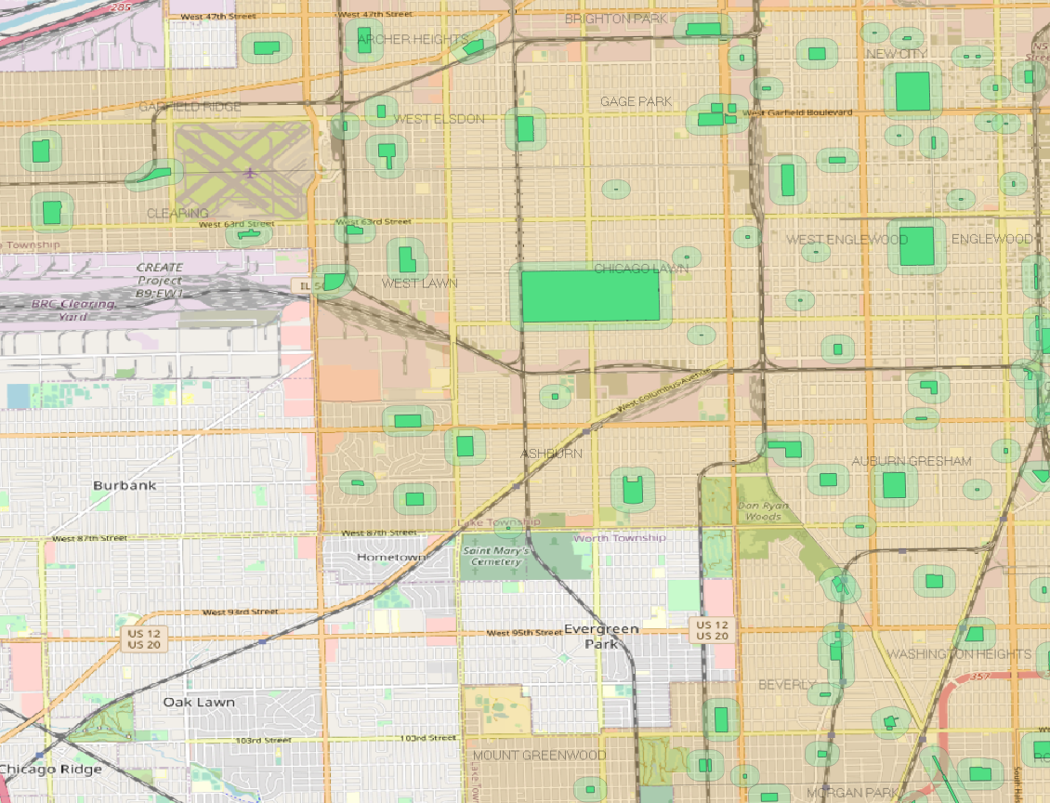
Parks with 200 m buffer

Slide 20
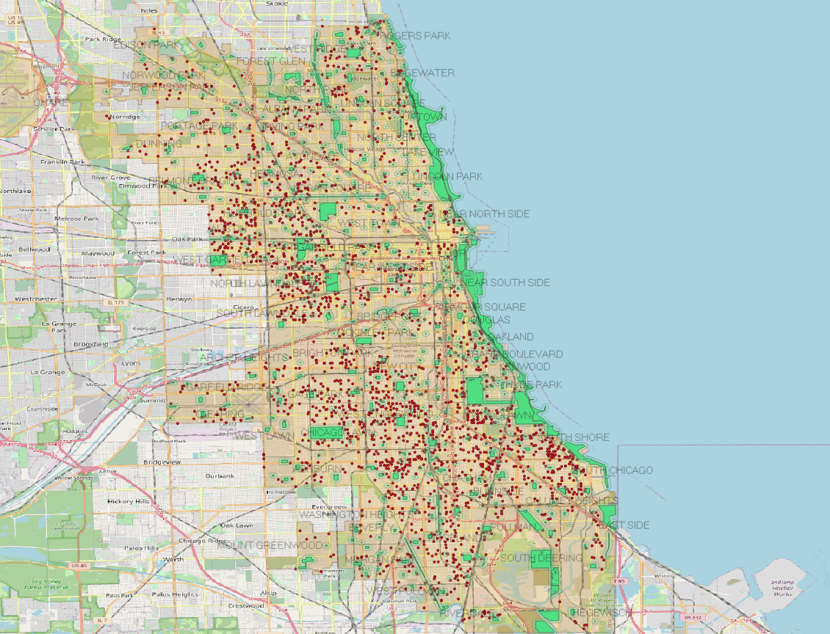
Parks and crimes

Slide 21
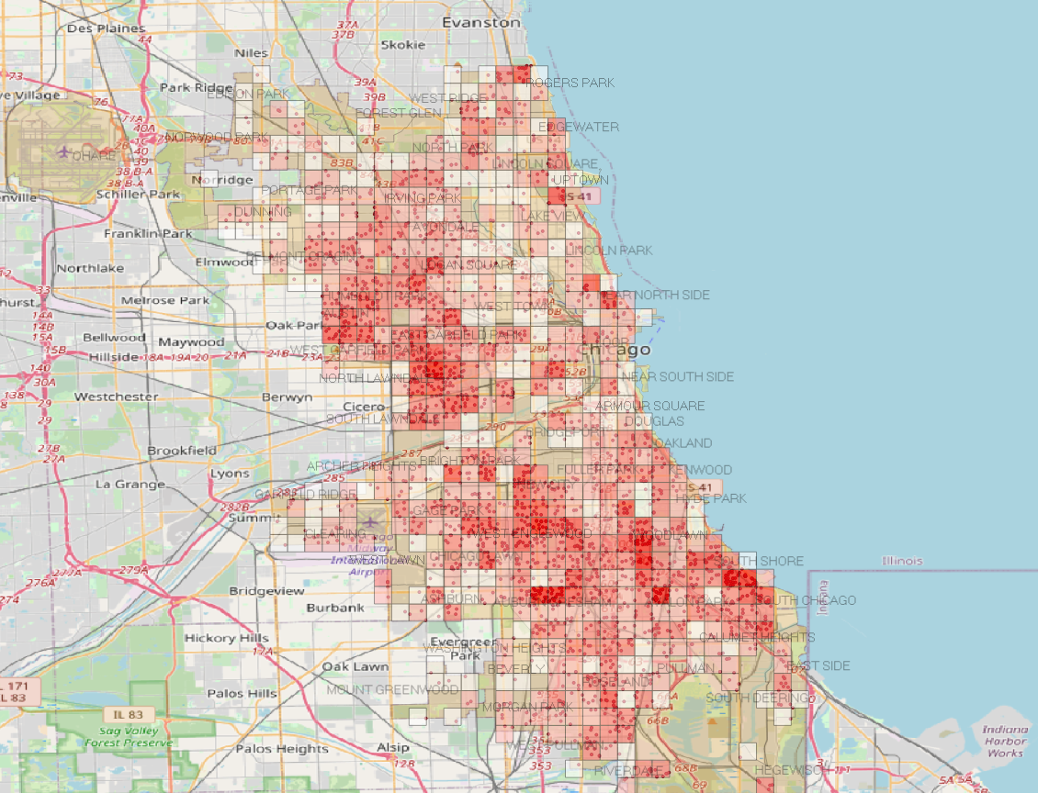
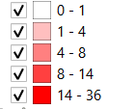
Grids representing the crimes

Slide 22
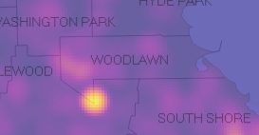
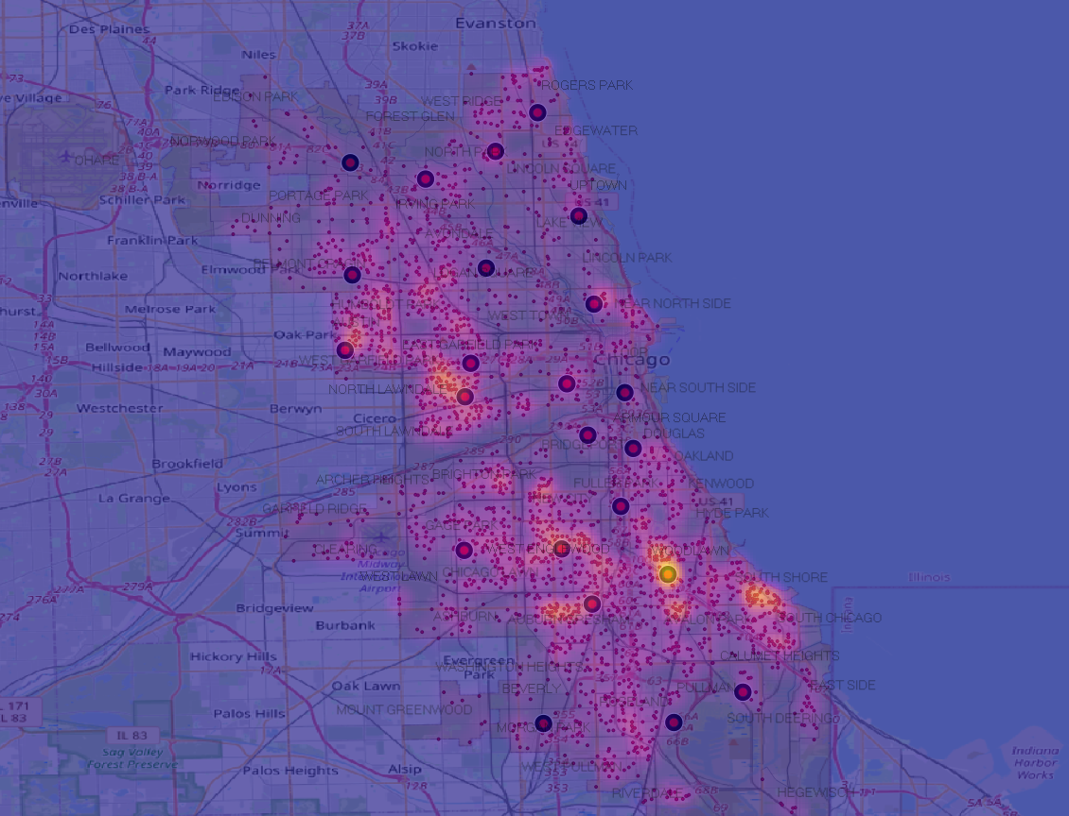
Heat Map

Slide 23
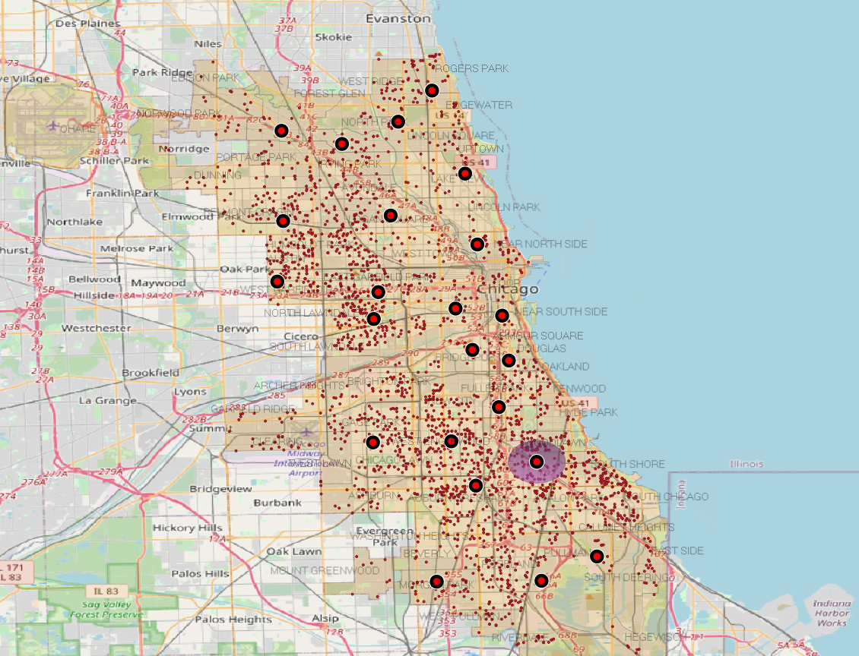
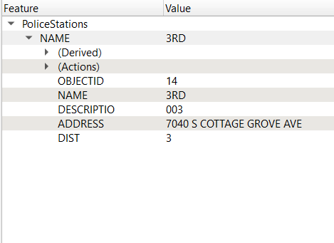
Police station with maximum cases within 2km

Slide 24
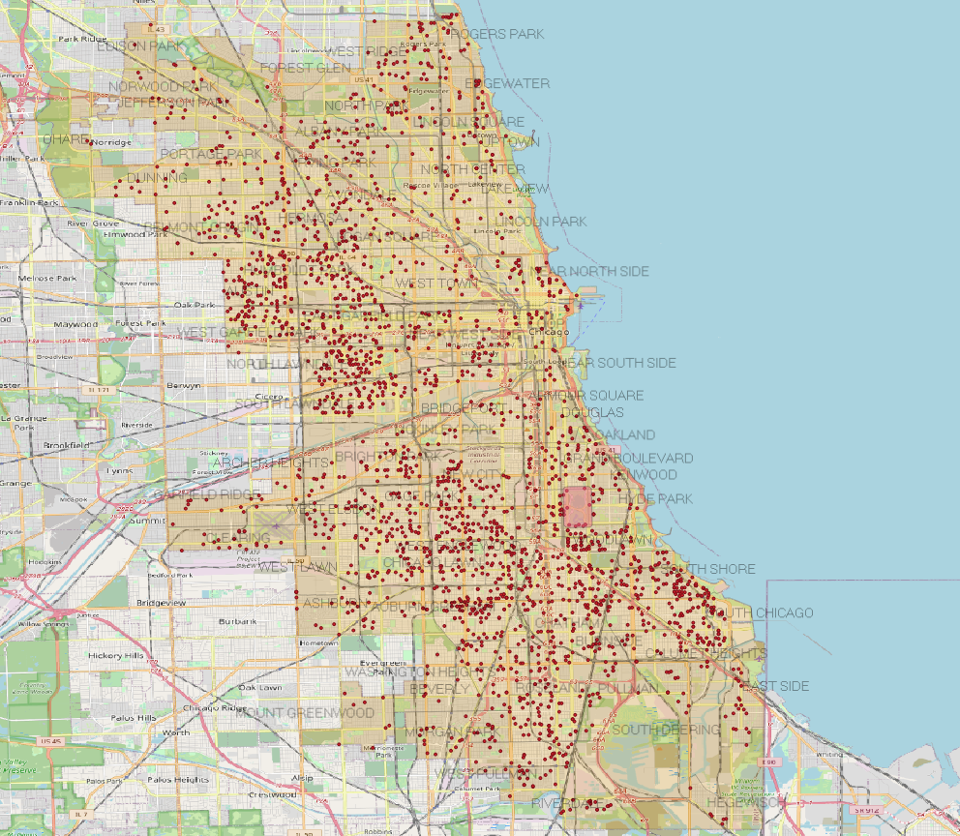
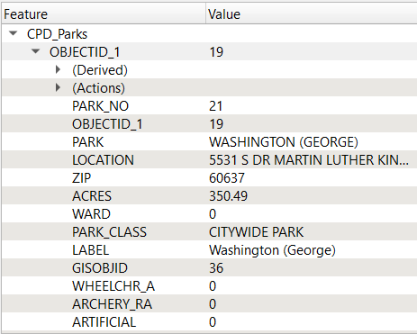
The park with maximum cases around 200m of its boundary

Slide 25
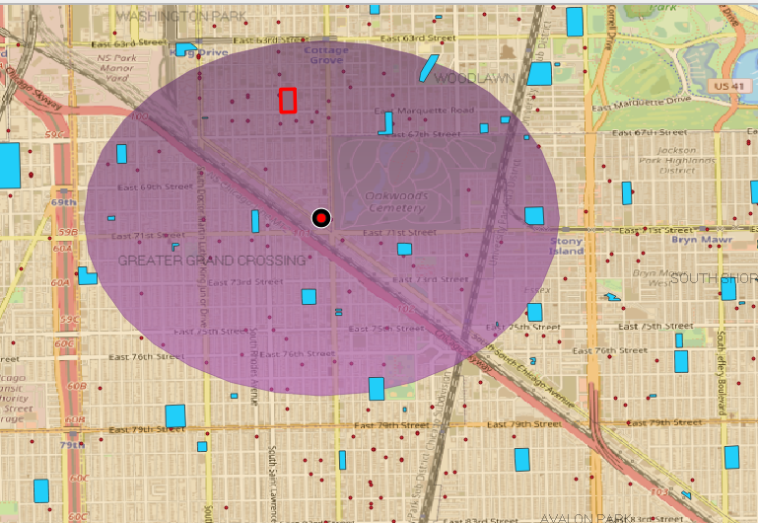
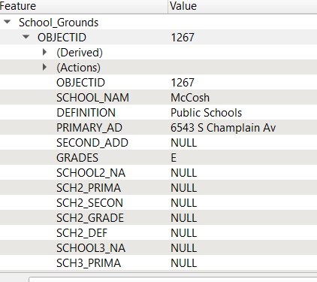
School with maximum cases within 200 m

Slide 26
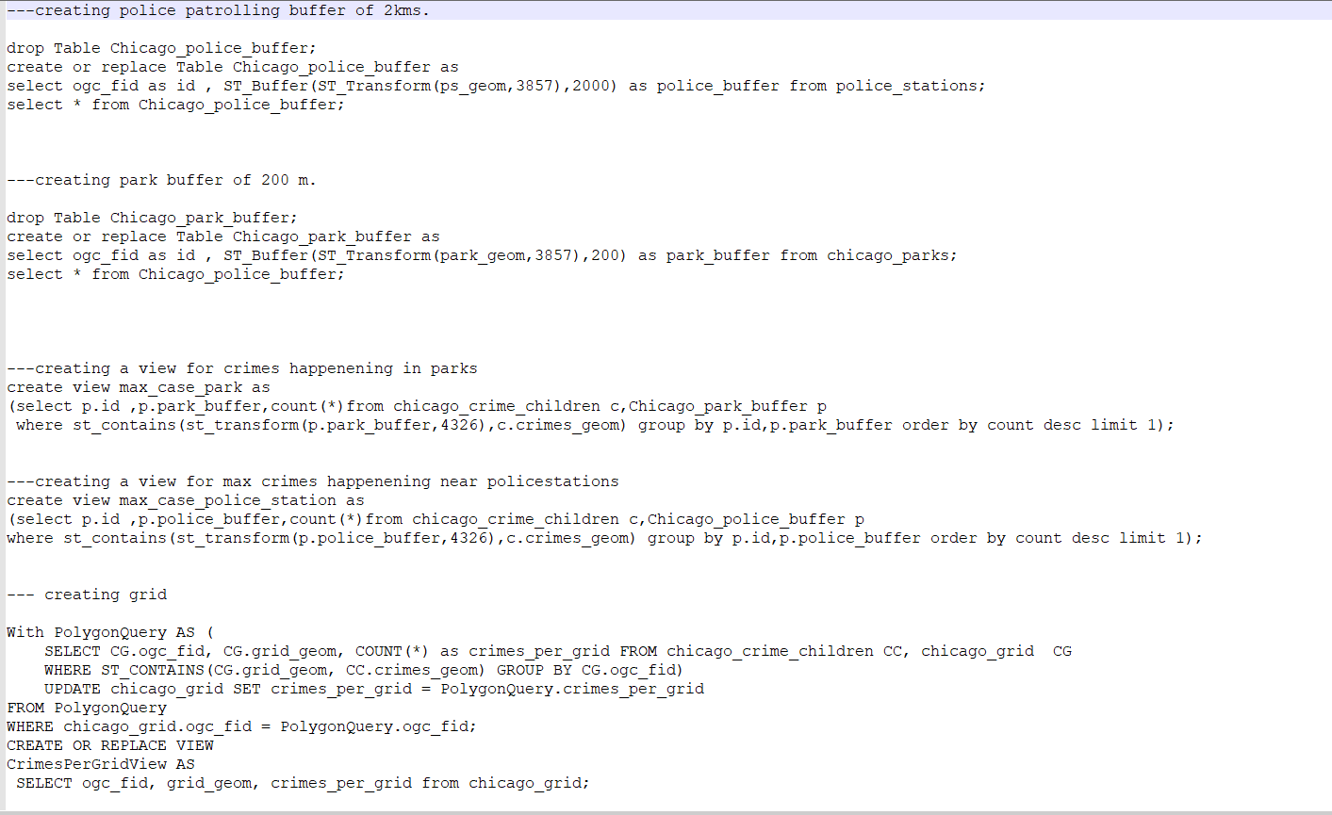
Sql tables and views for displaying the data.

Slide 27
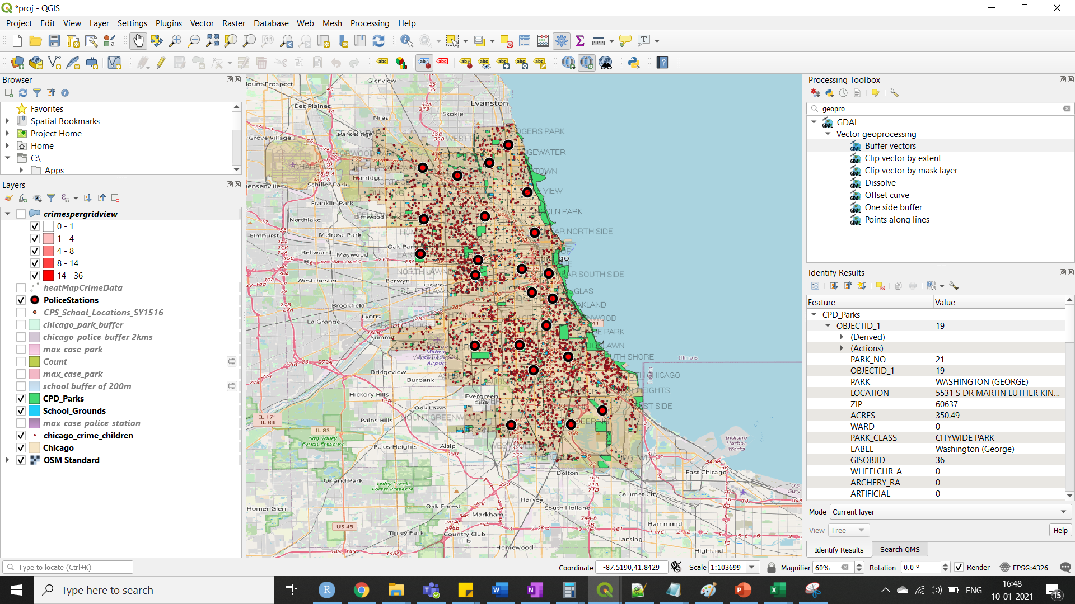
Qgis snap of all the layers.

Slide 28
Conclusion
I conclude by stating that , major steps should be taken by the government to safe-guard children where we see a lot of cases of such kind.
Police’s and guardian ‘s vigilance could greatly impact in lowering down the rates of crimes in the affected area.
we see through the map that “Wood lawn” is a dangerous neighborhood in Chicago and it is backed up by the link below:
https://lonelyplanet.com/thorntree/forums/americas-united-states-of-america/united-states/dangerous-neighborhoods-in-chicago
And finally this project has been uploaded to the git repos for reference.
https://github.com/Atikant/ChicagoCrimeQgis

Slide 29
Thank You !!

